Slide 1
ProjectZ
Outdoor game on android

Slide 2
Summary
Team introduction
Project
Features
WBS & Gantt
Mockup
Q&A

Slide 3
Team
Musstapha Moussaab Aouas 16129175
Le-Hoang Du 16129107
Xu Alexandre 16129123
Force Kévin Quentin Morgan 16129138
Amriche Sami 16129155

Slide 4
Project
It’s an android game : the user will create his/her hero and will dwell on the surface of this earth forever searching the Dragon Balls. The dragon balls will helps the player to up his/her stats and therefor helps him to win the fights.
Our users will be the teenagers, also the young mens and all the dragon ball lovers, whom like to go outside to play alone or with some friends when the weather is good.
The game will take place in the big citys. Every city will have it’s 7 dragon balls.

Slide 5
Features
The app will use the following features :
GPS
NFC
AR
Sensors
Network
Camera
Map

Slide 6
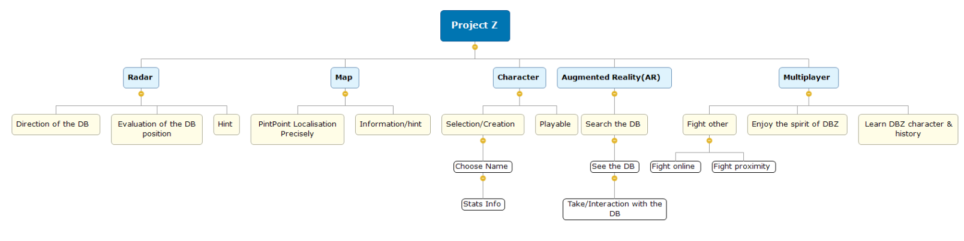
WBS

Slide 7
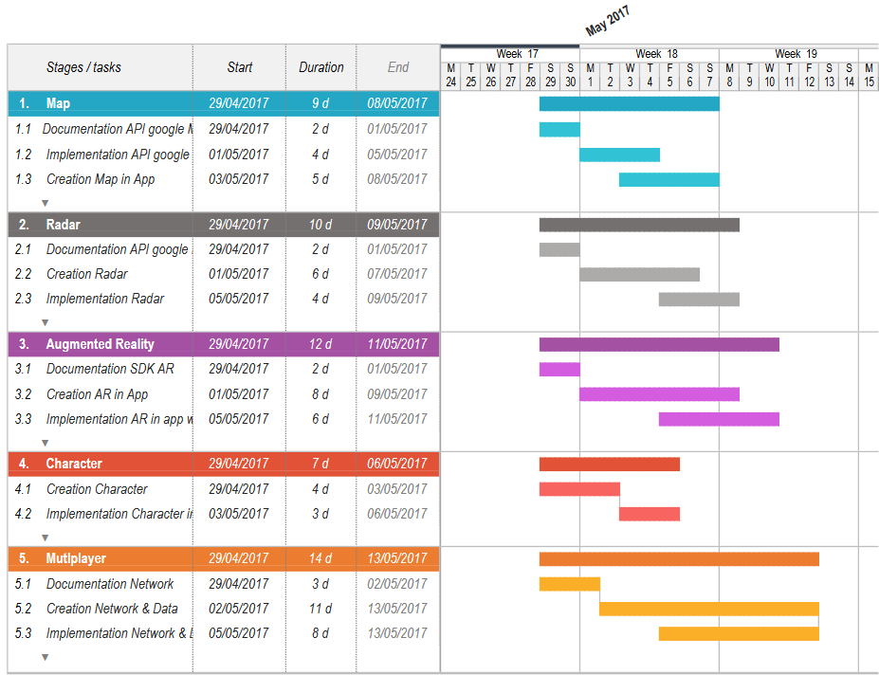
gantt

Slide 8
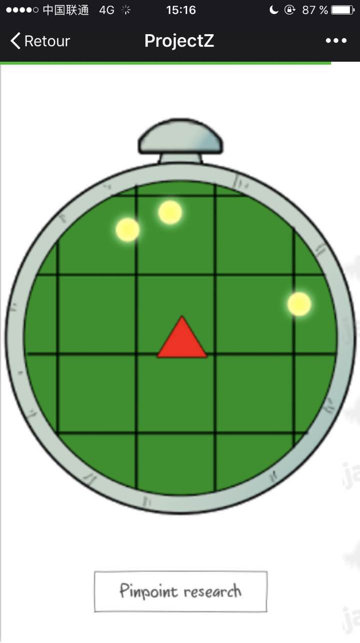
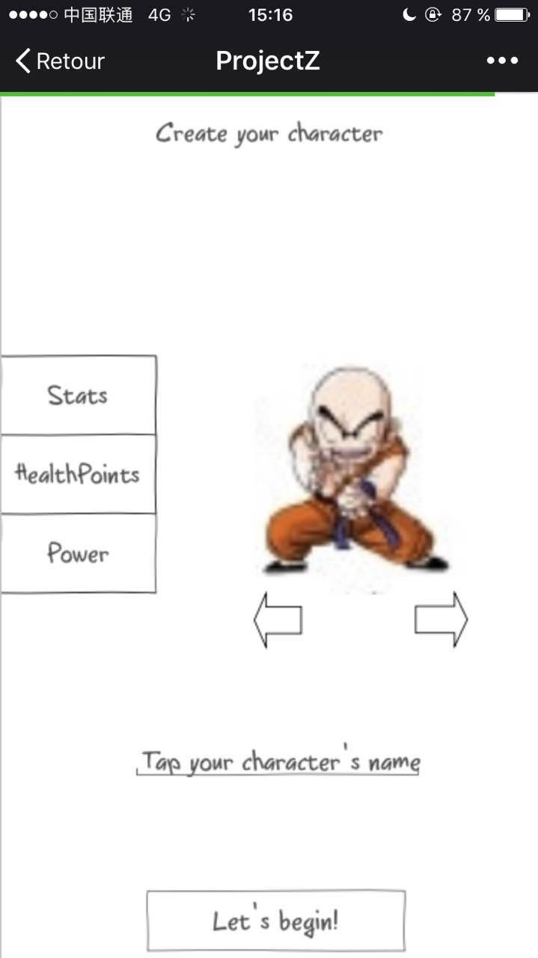
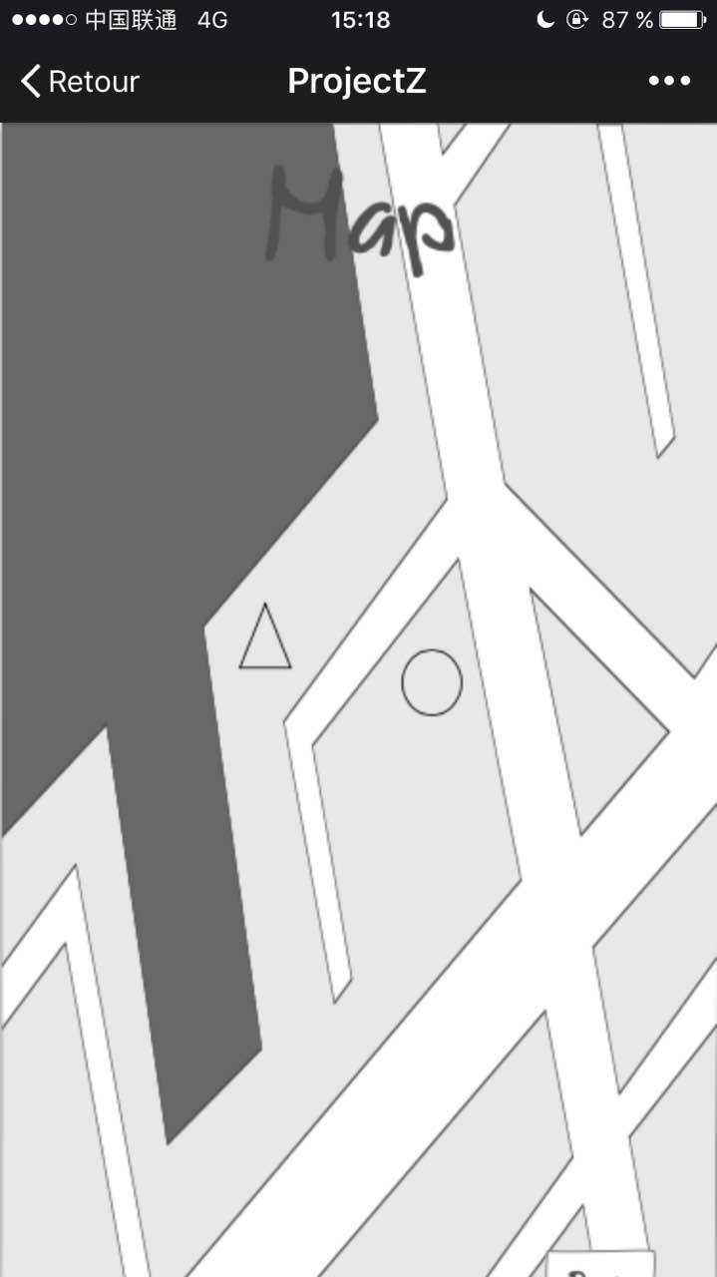
Mockup

Slide 9
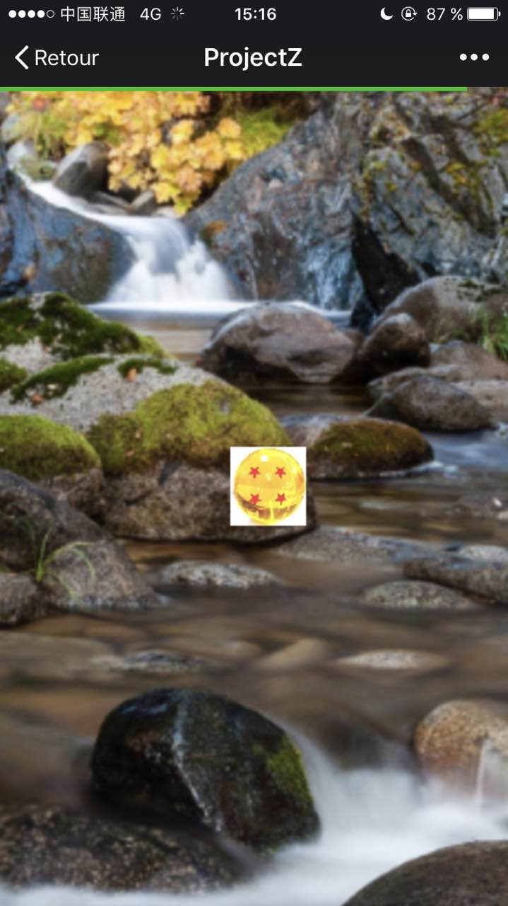
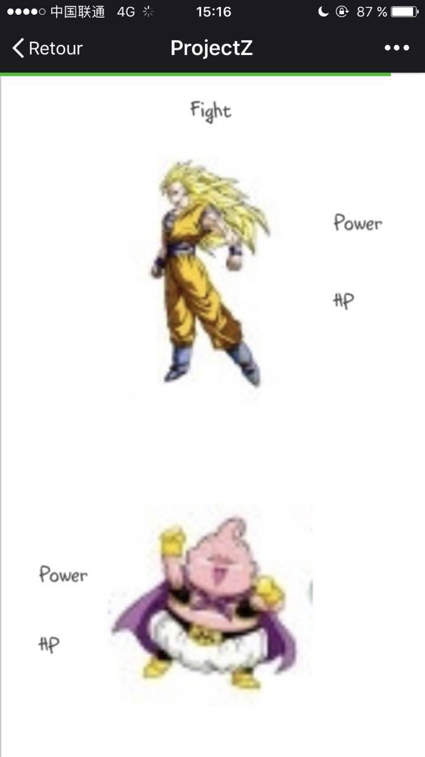
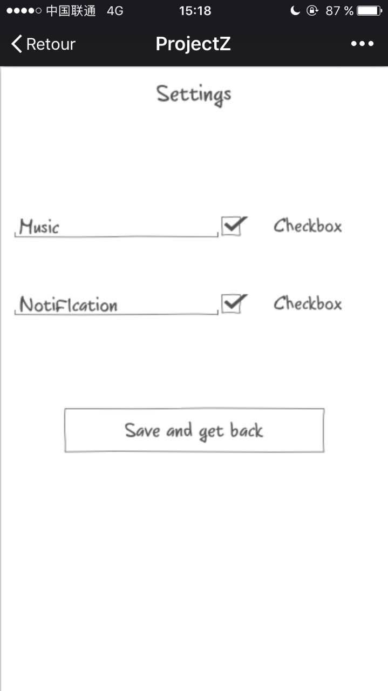
MOKUP

Slide 10
Thank you for listening

